Slide 1


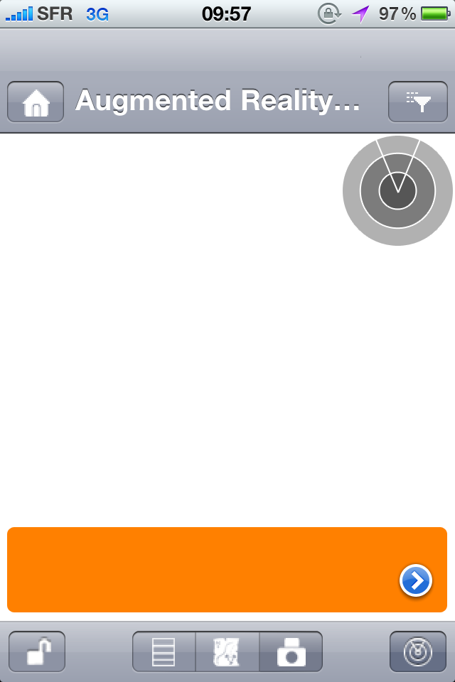


Filter by: Branch
N
Highstreet
NE 0.1km
Operations +23%

Slide 2




Filter by: Maintenance History
N
Tower Pipe 3
E 0.1km
Last Maintenance: 2 Weeks
Photo by Thomas Hawk, Flickr

Slide 3

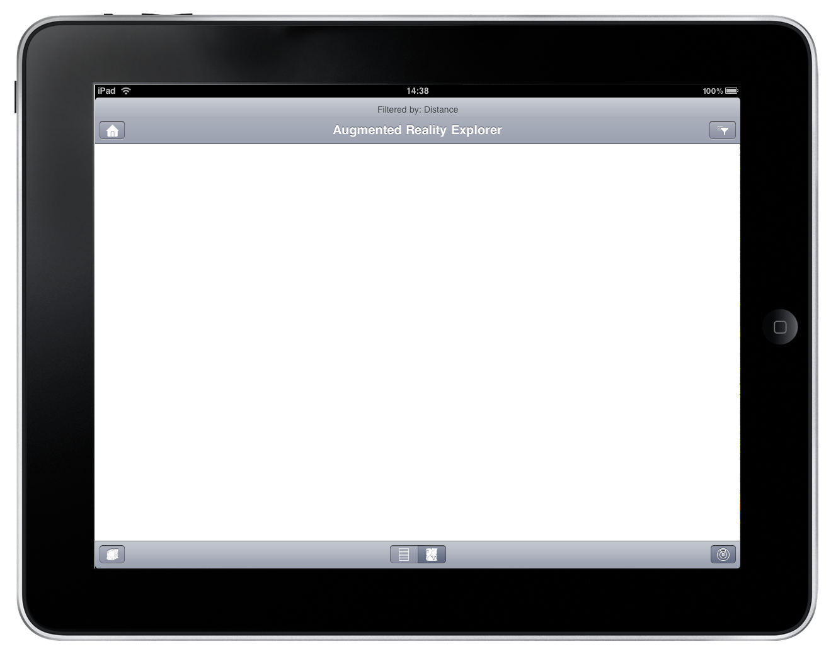
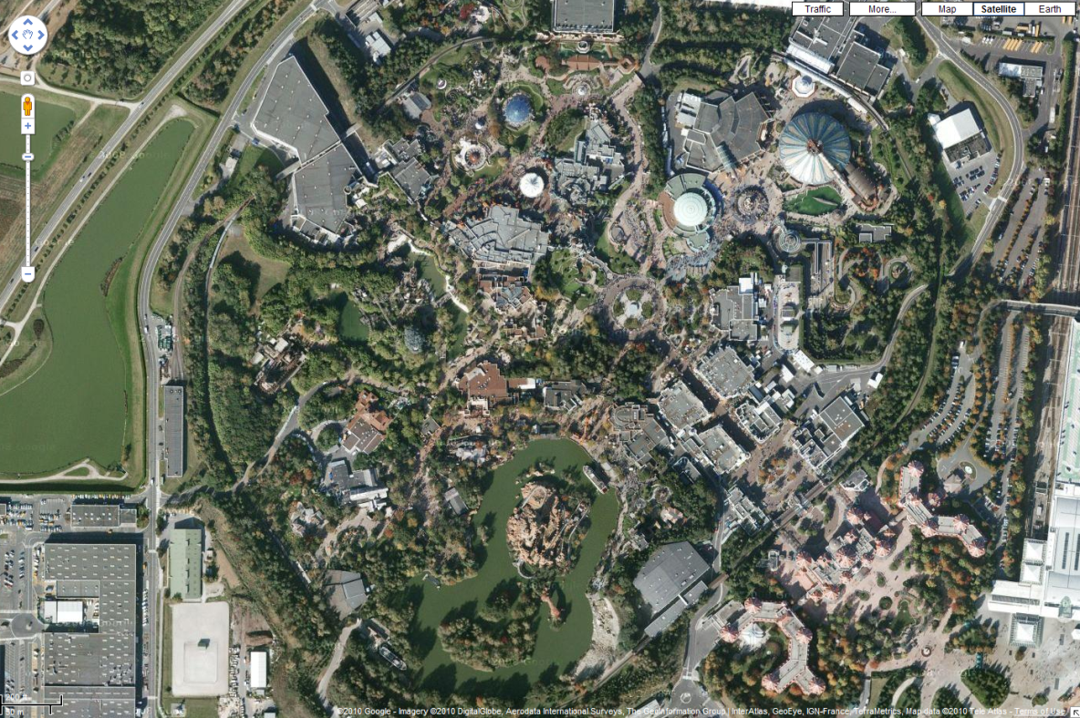

Slide 4




Filter by: Store Performance
N
Store 23
SE 0.1km
Current sales: $15k

Slide 5








How Augmented Explorer Works
Define the points of interest and associated data and load them into BusinessObjects Explorer
Calculate direction and distance to POIs, based on the users’ GPS location and compass
1
2
Corporate Explorer server or BI OnDemand
Corporate Data
Any source of corporate or personal data
Location
Latitude
Longitude
Angle and Distance
3
Display appropriate information on the mobile device
Target
Latitude
Longitude

Slide 6
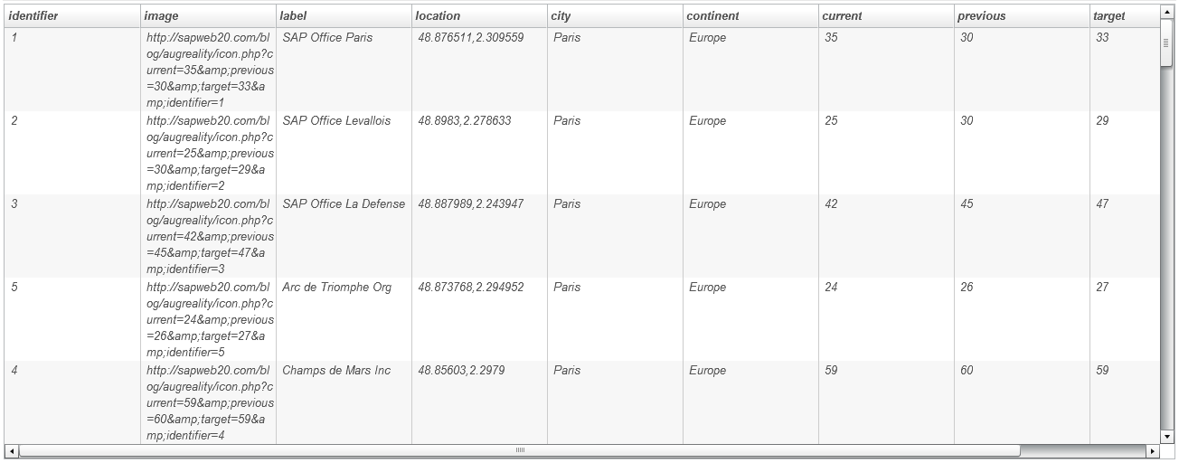
Augmented Explorer
Data model
Upload a data set to BI OnDemand. Open the SAP BusinessObjects Explorer for iPhone/iPad application. Choose a dataset/infospace to visualize: if it contains specific fields, it will be visualized in Augmented Reality mode.
Required fields for Augmented Explorer:
Each POI is defined by an ID, an image URL, a label, and location coordinates (latitude, longitude)
Next fields (measures):
Each POI can have many lines of information associated with it (dimensions and measures)
Notes:
The application will geolocalize the POIs thanks to these information, and together with the user’s location and iPhone compass it will be able to filter according to distance or orientation

